Slide 1
City/Town ARPA Presentation

Slide 2
Who we are
March 4, 2022
Notes:
Ben

Slide 3
Health Resources in Action
www.hria.org
Our mission is to help people live healthier lives and create healthy communities through prevention, health promotion, policy, and research. We work with governments, healthcare institutions, public agencies, philanthropy, and CBOs to improve population health and reduce health inequities.
Our core services include:
capacity building assistance (e.g., training, technical assistance, strategic planning);
research and evaluation (e.g., assessment, research, program evaluation, and quality improvement); and
grant making for biomedical research and community health initiatives.
Notes:
Why HRiA?
Use of an Equity Lens
Thoughtful community engagement
Customizable process to meet the needs of our partners and the context and environment in which the work is being done
60+years of experience
Adaptable and flexible

Slide 4
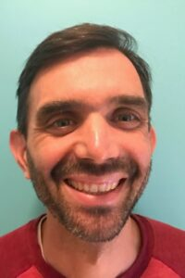
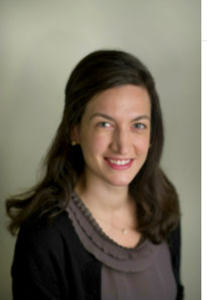
Core ARPA Team
Ben Wood
Senior Director, Policy & Practice
Mo Barbosa,
Senior Director, Community Engagement
Erika Gaitan
Senior Manager, Community Impact
Kathleen McCabe
Managing Director, Policy and Practice

Slide 5
The Opportunity
Barr Foundation Funding
HRiA awarded funding to support equitable community processes for decision-making and use of American Rescue Plan Act funds.
Impact from community driven investments can:
Increase power to decide (not just provide input).
Normalize actions that demonstrate how government can collaborate with residents who have been historically excluded.
Mitigate harm and limit any unintended negative consequences arising from ARPA investments.
Notes:
Reference 2 pager

Slide 6
Current Work/Examples
March 4, 2022

Slide 7
Experience with Community Engagement
City of Chelsea ARPA Engagement
Provide professional facilitating and advisory services to the City of Chelsea’s community engagement process for ARPA funding
Engage community residents in creative approaches to giving input for funding priorities
Work with city leaders to set workplans, strategy, and reporting requirements
https://www.chelseama.gov/arpa
Notes:
We do this at the city level
$15M of the $45M decided through this Community Fund, allocated by the Community Advisory Committee

Slide 8
Experience with Grantmaking and Technical Assistance
Massachusetts Community Health Funds
Act as fiscal agent for the planning and implementation of the landmark revision of the Determination of Need (DoN) regulation
Operate the MA Community Health and Healthy Aging Funds through community centered approaches
Equip community grantees to develop collaborative effort to address equity, going upstream to policy, systems and environmental change
https://www.mass.gov/service-details/don-community-health-funds
Notes:
And the state level

Slide 9
Experience supporting BIPOC-Led and Serving Community Organizations
MA COVID-19 Community Grants Program works to reduce COVID-19 infections, morbidity, and mortality among Asian, Black, Indigenous, Latinx, and other people of color in our hardest hit cities and towns, as well as to support education and awareness of vaccination efforts in Massachusetts.
Grantees provided capacity building support and a learning community with peer organizations

Slide 10
Community Engaged ARPA Processes (examples)
Approaches/Strategies
The community entrusts a portion of ARPA resources to a resident committee that sets priorities and makes funding decisions
The community wants to elevate BIPOC voices through a priority setting process that will inform all ARPA funding decisions
The community has made initial ARPA funding decisions but wants support developing a transparent process for residents to monitor and weigh in on implementation of funds
Activities
help with developing a vision for resident engagement with a focus on specific populations assist the community with a strategy for identifying who would be on an advisory committee reviewing relevant data and information, collecting additional information as needed from community members including interviews or focus groups, community meetings facilitation of advisory committee meetings to set priorities, gain consensus help design RFP mechanisms and review processes help develop accountability processes for funding decisions and implementation
Notes:
Looking for partners. Willing to be creative, test out strategies, try new things.
Note the opportunity to be part of a learning community

Slide 11
Discussion
March 4, 2022
Notes:
Mo

Slide 12
Discussion Questions
How are City leaders thinking about community engagement in terms of ARPA?
What processes currently exist for public input, if any?
What opportunities exist to enhance engagement?
What lessons from the first round of ARPA funding exist about who was involved and who wasn't?
Who tends to be left out of city decision-making processes and what has been tried in the past to engage with them?
What supports would be most useful as City leaders make allocation decisions?
What would success look like?

Slide 13
Thank you!
Contact information:
Mo Barbosa
Senior Director, Community Engagement
Health Resources in Action
mbarbosa@hria.org
www.hria.org
Notes:
Mo

